Slide 1
Assortative Mixing
MA 653: Network Science
Instructor: Ashok Singh Sairam
ashok@iitg.ac.in

Slide 2
Homophily and assortative mixing
People tend to associate with others whom they perceive as being similar to themselves in some ways
The “similar” characteristics can be age, race, religion, nationality, etc
This tendency is called Homophily or assortative mixing
Disassortative mixing
Tendency of people to associate with others who are unlike them
It is also possible such as in marriage
We will look at how assortative mixing can be quantified

Slide 3
Ex: Homophily mixing
Figure presents the friendships in a high school
Nodes are annotated with regards to their race

Slide 4


Assortative mixing
Consider a network where each vertex is classified according to a discrete characteristic, that can take a finite number of values
E.g., race, nationality, etc.
The network is assortative if a significant number of edges run b/w nodes of the same type
Find the # of edges that run between vertices of the same type and subtract from it the fraction of such edges that we would expect to find if edges where placed at random (i.e., without regard for the vertex type)
If the result is significantly positive → assortativity mixing is present
If the result is significantly negative → disassortativity mixing is present

Slide 5
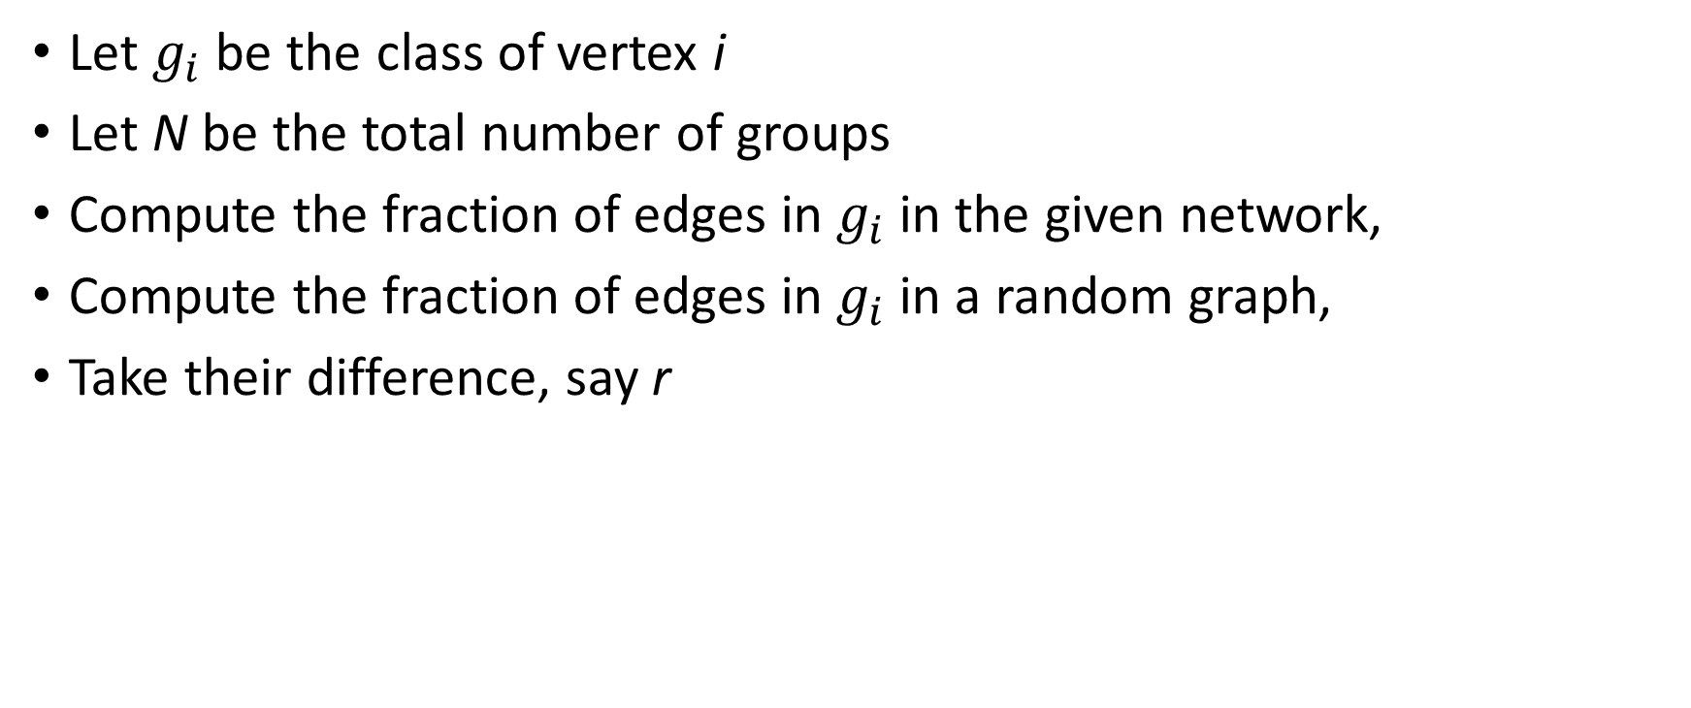
Computing Assortative Mixing
Let $g_{i}$ be the class of vertex i
Let N be the total number of groups
Compute the fraction of edges in $g_{i}$ in the given network,
Compute the fraction of edges in $g_{i}$ in a random graph,
Take their difference, say r

Slide 6
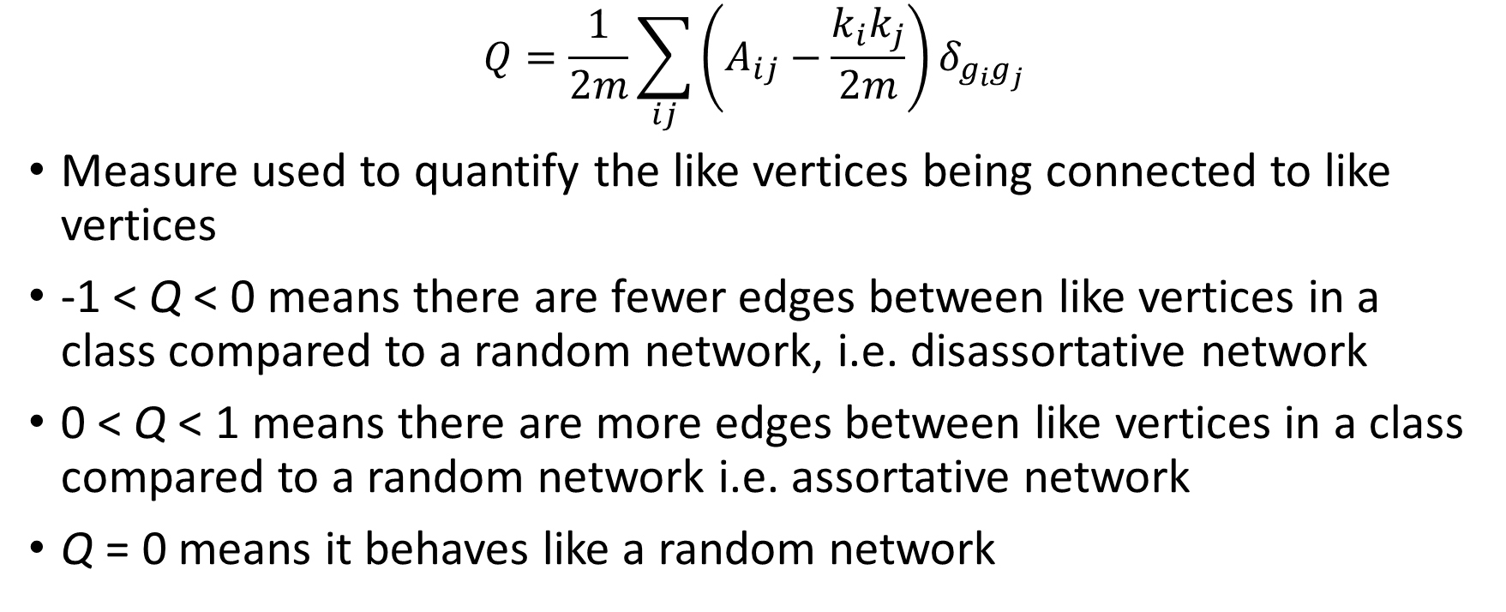
Modularity
$$Q=\frac{1}{2m}\sum_{ij}{\left(A_{ij}−\frac{k_{i}k_{j}}{2m}\right)δ_{g_{i}g_{j}}}$$
Measure used to quantify the like vertices being connected to like vertices
-1 < Q < 0 means there are fewer edges between like vertices in a class compared to a random network, i.e. disassortative network
0 < Q < 1 means there are more edges between like vertices in a class compared to a random network i.e. assortative network
Q = 0 means it behaves like a random network

Slide 7
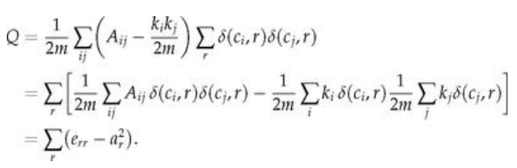
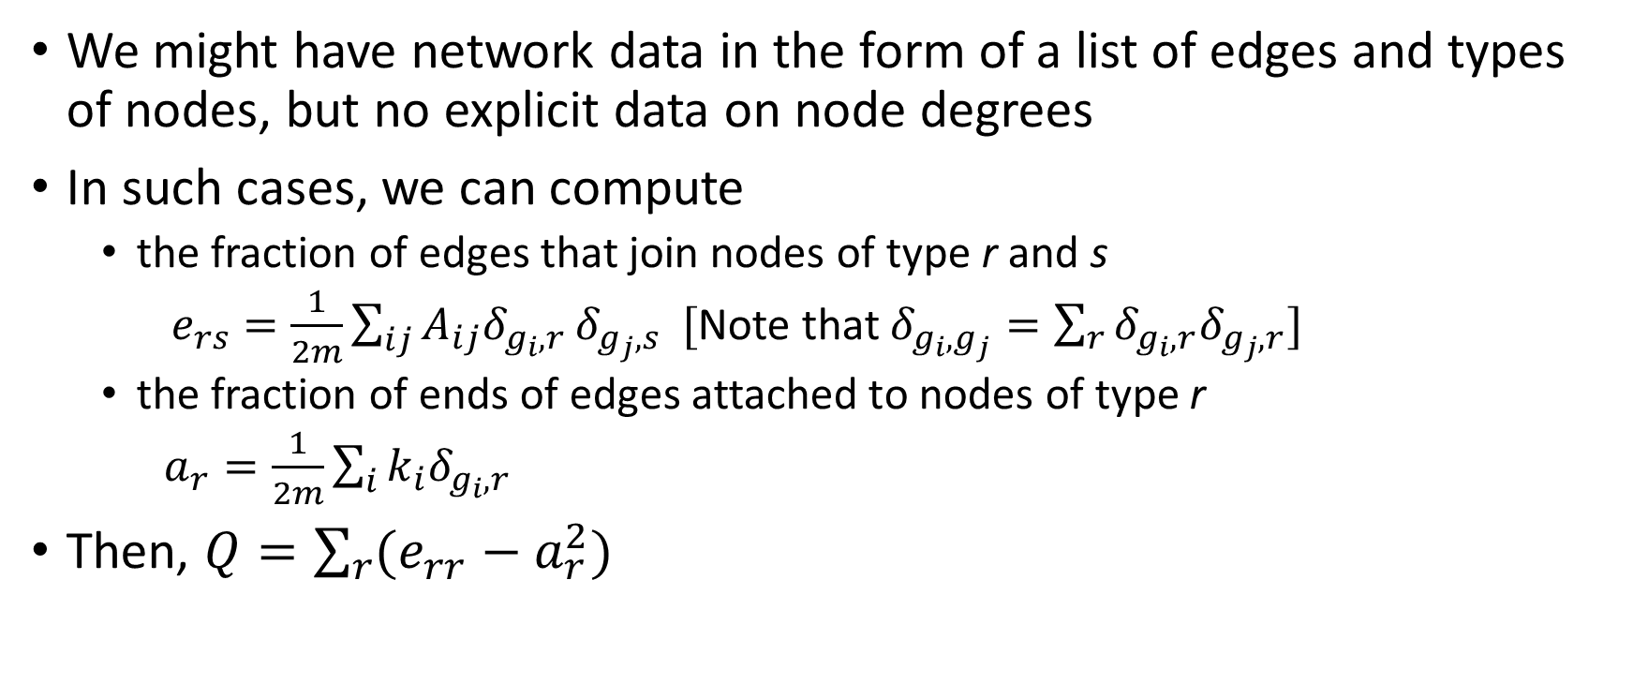
Alternative form of Modularity
We might have network data in the form of a list of edges and types of nodes, but no explicit data on node degrees
In such cases, we can compute
the fraction of edges that join nodes of type r and s
$e_{rs}=\frac{1}{2m}\sum_{ij}{A_{ij}δ_{g_{i},r}}δ_{g_{j},s} [$Note that $δ_{g_{i},g_{j}}=\sum_{r}{δ_{g_{i},r}δ_{g_{j},r}}]$
the fraction of ends of edges attached to nodes of type r
$a_{r}=\frac{1}{2m}\sum_{i}{k_{i}δ_{g_{i},r}}$
Then, $Q=\sum_{r}{(e_{rr}−a_{r}^{2})}$
Notes:
Most real networks do not have degree info.
$\sum_{ij}{A_{ij}δ_{g_{i},r}}δ_{g_{j},s}$ : <i,j> is an edge. g_i,r means one end of edge <i,j> is on nodes of type r and the other end of the edge g_j,r is on Here g_ir represents one end of an edge that ends

Slide 8
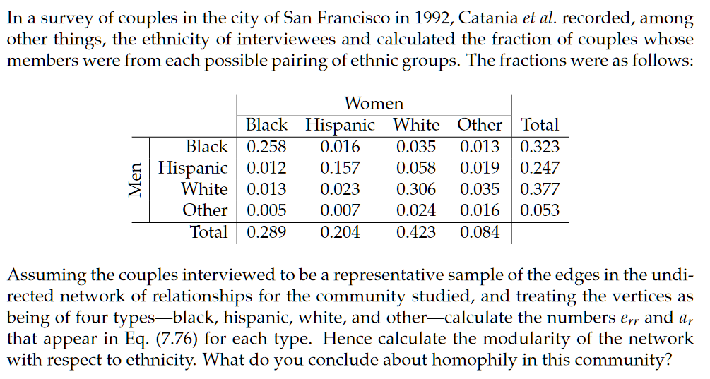
Exercise
Ex. 7.16 (a)

Slide 9
Scalar characteristics
Assortative mixing can occur in a network according to scalar characteristics (such as age, income, etc.) whose values come in a particular order
For example using age: two people are similar if:
they are born the same day or
within a year or within x years,
They are in the same class
Same generation
If people are friends with others of the same age, we consider the network assortatively mixed by age (or stratified by age)

Slide 10
Ex: Assortativity by grade/age

Slide 11
Enumerative scalar characteristics
When we consider scalar characteristics we basically have an approximate notion of similarity between adjacent vertices (i.e. how far/close the values are)
There is no approximate similarity that can be measured this way when we talk about enumerative characteristics; rather present/absent
Example: gender, race

Slide 12
Ex: Assortative mixing by age
Each dot corresponds to an edge between pair of friends
There is substantial assortative mixing by age
friendship between students of the same grade

Slide 13
Computing Assortative Mixing by Scalar characteristics
Simple solution would be to quantize/bin scalar values
That is group nodes into bins according to the characteristics of interest (say age) and treat the bin as a separate node
The above misses much of the point of scalar characteristics
Treat vertices that fall in the same bin as exactly same when they may be approximately so
Treat vertices in different bins to be entirely different when in fact they may be quite similar
A better approach would be to apply the modularity metric for enumerative characteristics

Slide 14
Scalar characteristics: covariance measure(1)
x_{i} is the value of the scalar characteristic (age, income, etc) of vertex i
If x_{i} is the variable describing the characteristic at vertex i and x_{j} is the one for vertex j, then we want to calculate the covariance of these two variables over the edges of the graph
First, we need to compute the mean value of x_{i} at the end i of an edge:

Slide 15
Scalar characteristics: covariance measure (2)
Hence, the covariance of x_{i} and x_{j} over the edges is:
If the covariance is positive, we have assortativity mixing, otherwise we have disassortativity
As with the modularity Q we need to normalize the above value so as it gets the value of 1 for a perfectly mixed network
All edges fall between vertices that have the same value x_{i} (highly unlikely in a real network)

Slide 16
Scalar characteristics: covariance measure (3)
Setting x_{i}=x_{j} for all the existing edges (i,j) we get the maximum possible value (which is the variance of the variable):
Then the assortativity coefficient r is defined as:
r=1→Perfectly assortative network
r=-1→Perfecrtly disassortative network
r=0→no (linear) correlation

Slide 17
Assortative mixing by degree
A special case is when the characteristic of interest is the degree of the node
Commonly used in social networks (the most used one of the scalar characteristics)
More interesting since degree is a topological property of the network (not just a value like age or grade)
This now reduces to Pearson Correlation Coefficient

Slide 18
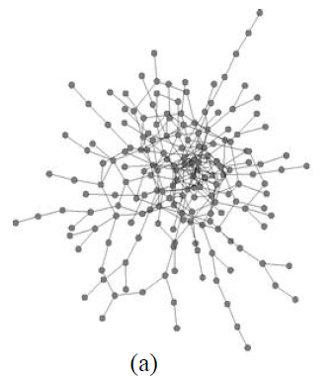
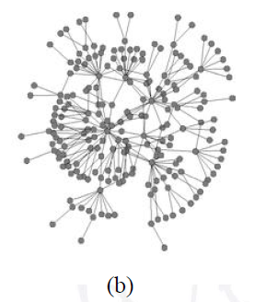
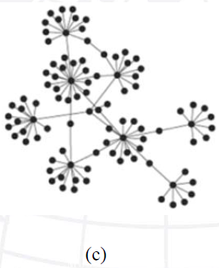

Ex: Assortative mixing by degree
Assortative network by degree $→$ core of high degrees and a periphery of low degrees (Figure (a) below)
Disassortative network by degree $→$ uniform: low degree adjacent to high degree (Figure (b) and (c) below)

Slide 19
Assortative mixing by degree
Assortative mixing by degree requires only structural information for the network
No knowledge for any other attributes is required

